Slide 1
MCA Final Year Project (Review I) E-Mail Spam Detection Using Machine Learning
Submitted to the Presidency University, Bengaluru in partial fulfillment for the award of the degree of Master of Computer Applications(MCA)
Project Number : 215
Under the supervision of
Mr. Sakthi S Asst. Prof, Department of SCSE School of Computer Science and Engineering
Name | Roll Number
Ashwini Hosamani | 20232MCA0263

Slide 2
Content
Problem Statement
Literature Survey
Tools and Technologies to be used
GitHub
Timeline of the Project
References

Slide 3
Problem Statement
Spam detection helps filter out unwanted emails, but built-in filters are not always reliable, sometimes misclassifying important messages.
Spammers continuously evolve their techniques, making it challenging to maintain effective filtering systems.
Spam emails waste storage, consume time, cause financial losses for businesses, and pose cybersecurity threats like malware and phishing.
This project evaluates multiple AI models on the same dataset, comparing their performance based on accuracy and efficiency.

Slide 4
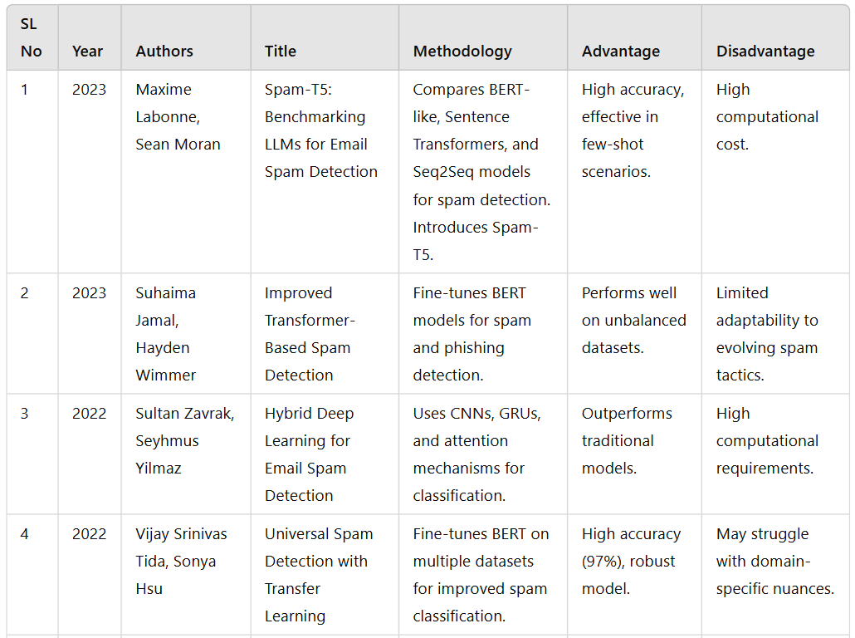
Literature Review

Slide 5
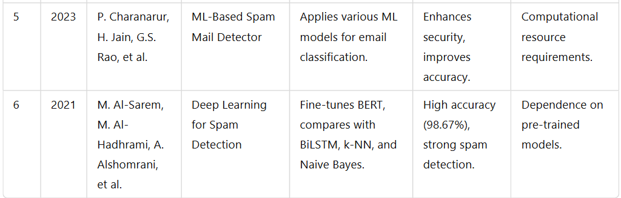

Slide 6
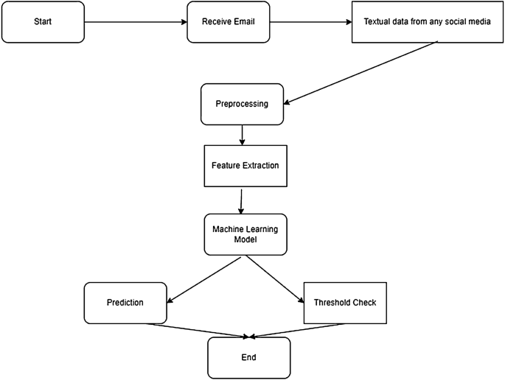
Module Design

Slide 7
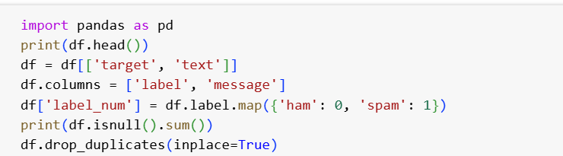
Modular Breakdown
Module 1: Email Data Cleaning and Preprocessing
Functionality:
Extracts email content (subject, body, metadata) for analysis.
Removes unnecessary elements like HTML tags, stopwords, and special characters.
Importance:
Ensures high-quality input data for accurate spam classification.
Reduces noise and enhances meaningful feature extraction.

Slide 8
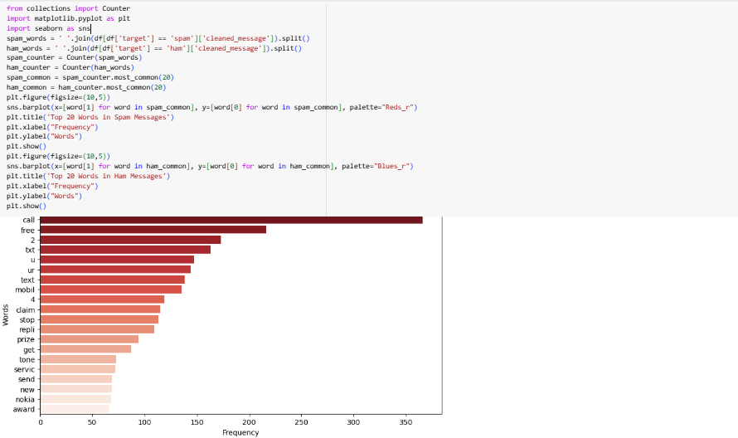

Slide 9
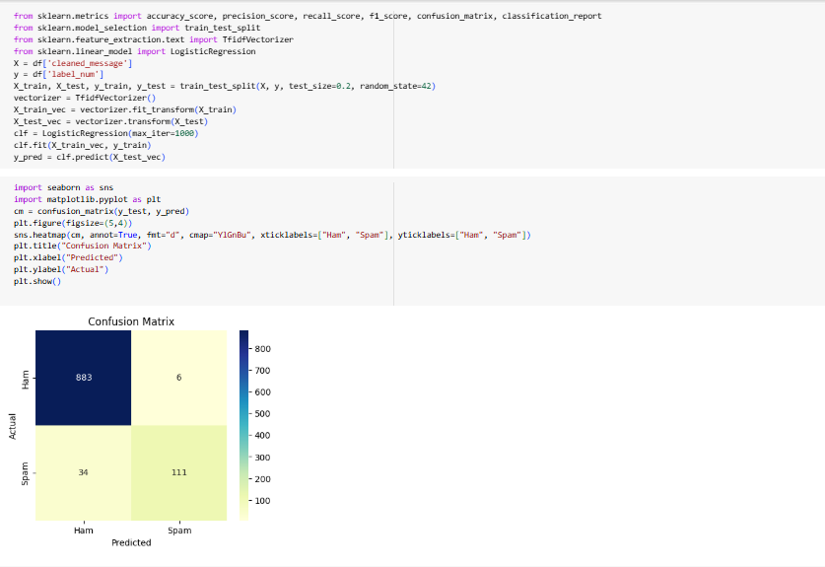
Module 2: Spam Classification using Machine Learning
Importance:
Forms the core of the system by identifying and filtering spam emails.
Improves detection accuracy, reducing false positives and false negatives.

Slide 10
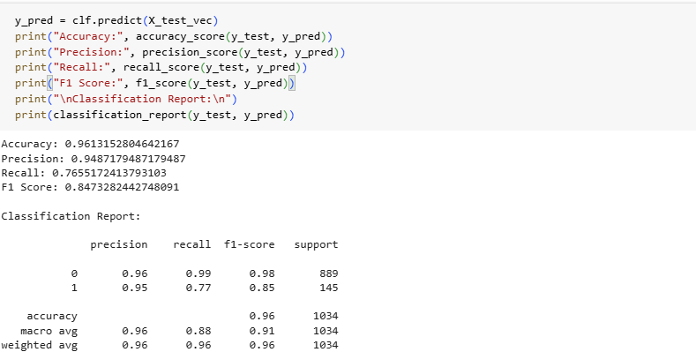

Slide 11
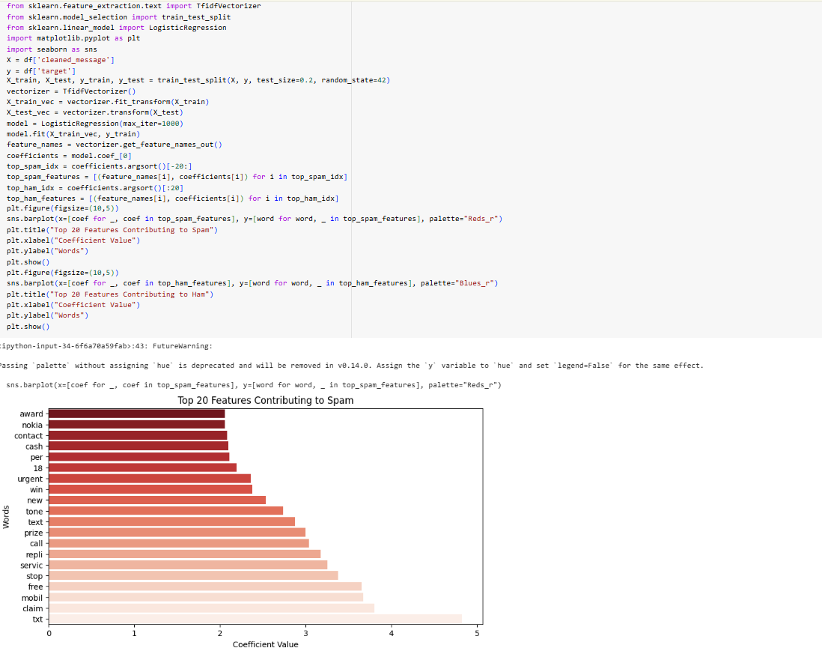
Module 3: Feature Extraction & Selection
Functionality:
Extracts key features from emails such as word frequency, presence of URLs, metadata analysis.
Uses N-grams, TF-IDF, and Word Embeddings for text representation.
Importance:
Enhances model efficiency by reducing irrelevant data.
Improves spam classification accuracy by focusing on key indicators.
Module 4: Model Deployment & System Integration
Functionality:
Integrates with email clients (e.g., Gmail API, Outlook API) for seamless filtering.
Continuously updates the model using feedback from user-labeled emails
Importance:
Provides an adaptive system that improves over time based on new spam patterns.

Slide 12
Module 4: Model Deployment & System Integration
Functionality:
Integrates with email clients (e.g., Gmail API, Outlook API) for seamless filtering.
Continuously updates the model using feedback from user-labeled emails
Importance:
Provides an adaptive system that improves over time based on new spam patterns.

Slide 13
Tools And Technologies To Be Used
1. Development Tools:
Google Colab / Jupyter Notebook – For coding and testing the machine learning model.
2. Programming Language:
Python – For implementing facial recognition and the music recommender system.
3. Frameworks & Libraries:
Scikit-learn – For machine learning algorithms and feature selection.
NLTK / SpaCy – For text preprocessing and natural language processing tasks.
TensorFlow / Keras – For building and training deep learning models.
4. Additional Tools:
Gmail API / Outlook API – For integrating the spam detection system with email clients.
Flask / FastAPI – For deploying the trained spam detection model as an API.

Slide 14
GitHub Link
https://github.com/ashwinihosamani/Email-Spam-Detection-Using-Machine-Learning

Slide 15
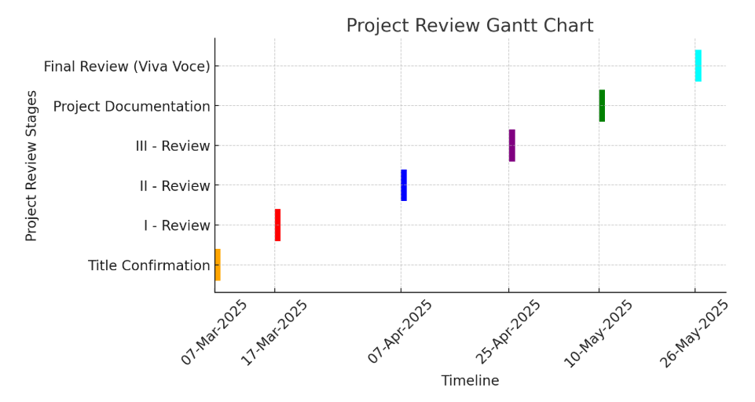
Timeline of the Project

Slide 16
References
M. Labonne and S. Moran, "Spam-T5: Benchmarking LLMs for Email Spam Detection," in Proceedings of the International Conference on Computational Linguistics (COLING), 2023.
S. Jamal and H. Wimmer, "Improved Transformer-Based Spam Detection," Journal of Artificial Intelligence Research (JAIR), vol. 35, pp. 120-135, 2023.
S. Zavrak and S. Yilmaz, "Hybrid Deep Learning for Email Spam Detection," IEEE Transactions on Neural Networks and Learning Systems, vol. 34, no. 6, pp. 987-999, 2022.
V. S. Tida and S. Hsu, "Universal Spam Detection with Transfer Learning," in Proceedings of the ACM Conference on Machine Learning (ACM-ML), pp. 230-242, 2022.
narur, H. Jain, G. S. Rao, et al., "ML-Based Spam Mail Detector," Springer Journal of Machine Learning and Applications, vol. 27, pp. 89-104, 2023.

Slide 17
M. Al-Sarem, M. Al-Hadhrami, A. Alshomrani, et al., "Deep Learning for Spam Detection," Expert Systems with Applications, Elsevier, vol. 167, pp. 113872, 2021.
M. A. Shafi, H. Hamid, E. G. Chiroma, J. S. Dada, and B. Abubakar, "Machine Learning for Email Spam Filtering: Review, Approaches and Open Research Problems," in Proceedings of the International Conference on Artificial Intelligence and Machine Learning (AIML), pp. 45-56, 2018.
M. Almeida, T. A. Almeida, and A. Silva, "Spam Email Detection Using Deep Learning Techniques," in Proceedings of the IEEE International Conference on Data Science and Advanced Analytics (DSAA), pp. 92-105, 2021..

Slide 18


